Slide 1
Capstone Project 1 Airbnb Booking Analysis
Team Members
Piyush Lanjewar Pruthvi Raj Yogesh Reddy

Slide 2

Content
Introduction
Problem statement
Handling missing values
EDA on given data
Visualizations
Conclusion

Slide 3

Introduction
Airbnb is one of the
largest used companies
for lodging primarily
homestays for vacation
rentals and tourism
activities. Today Airbnb
is one of the most used
brands for giving a good
experience to hosts
and guests.
The data is used to increase the
understanding of every detail to make traveling easy

Slide 4

and convenient. The data is utilized to show the required conclusions. The conclusions are also shown in the visualizations to make understanding easier.

Slide 5
Problem Statement
1) The primary factor of AIRBNB is to provide Homestays for Vacation rentals and tourism activities and none of the listed properties are owned by AIRBNB. It is just an online marketplace for all the listed properties.
2) The factor that affects this business is the Reviews. If the visited customers provide a positive review then there is a high chance that it gets booked several times based on the availability and in case of negative reviews customers are most likely don’t prefer to stay there.

Slide 6
3) By observing the provided data around 25% of the listed properties either be Home-apt. Or private rooms or shared rooms don’t have the reviews this doesn't help to maintain a healthy relationship with the hosts of the listed properties.
4) There is small inaccuracy in the dataset on price where around 10% of the properties are given with the price 0$ which doesn't relate at all. So to represent real data instead of using the mean to fill the faulty prices we applied Median.

Slide 7
Column features
host_name: The Name of hosts who give services to guests
Neighbourhood_group: Represents the city
Neighborhood: Represents areas of the city
Latitude and longitude: Represents the location of the house
room_type: Represents the type of room(shared/private/apt)
price: Represents price of the houses
minimum_nights: Nights spent by customers
number_of_reviews: Number of reviews
last_review: Date represents the last review by customers
reviews_per_month: Reviews per month
calculated_host_listings_count: Host count listing
availability_365: The availability of hosts per year

Slide 8
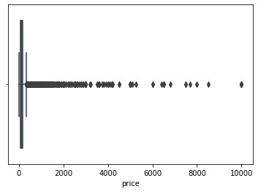
The box plot represents the
Price Column showing too
many outliers present in the
data.
So, we will use the mean in
place of zero values and NA
values.

Slide 9
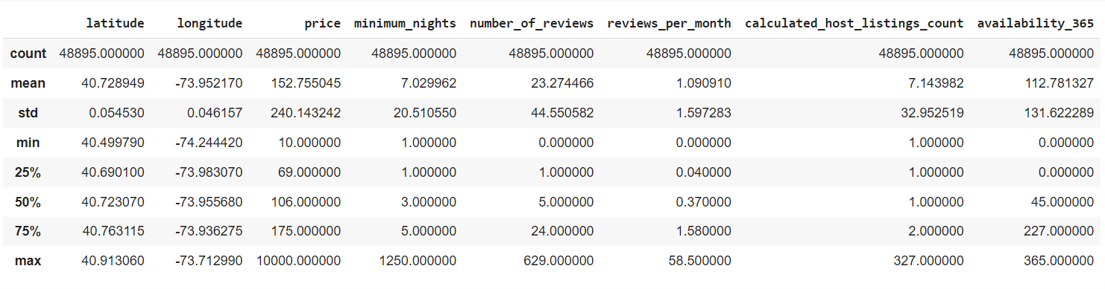

Slide 10
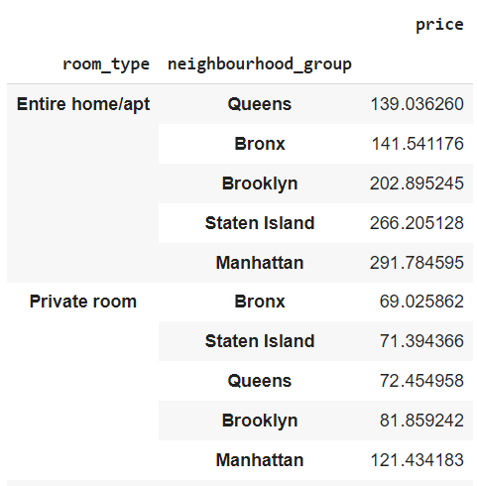
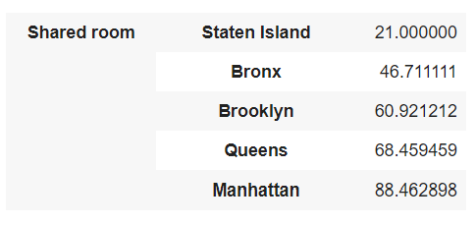
The list represents the average value of
The room types corresponding to the
Neighborhood group. The list can give
us the estimate of price listing in
different areas.

Slide 11
EDA
What is EDA?
EDA is an approach to analyzing data sets using statistical graphs and many visualizations tools. EDA shows us what data can tell beyond its formal modeling or hypothesis testing task. It provides a better understanding of the data and the dependence of its features over each other. It helps us to find and handle missing values and outliers. It helps us to manipulate the data sources and get the answers we need from the data. We get a better understanding of the problem statement.
Here in our problem, we have done some visualizations to understand the data.

Slide 12
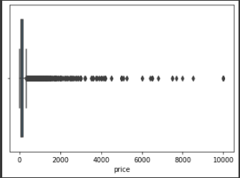
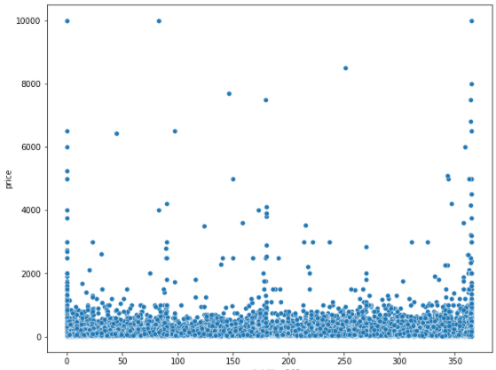
Outlier Data:
Outliers are the data points that affect the data at the model building which gives wrong predictions. The accuracy of the model is affected.
Here in our data, we are taking price and availability_365 for checking outliers.
BOX PLOT SCATTER PLOT
In the above two plots, we can see there are some outliers in the price feature.

Slide 13
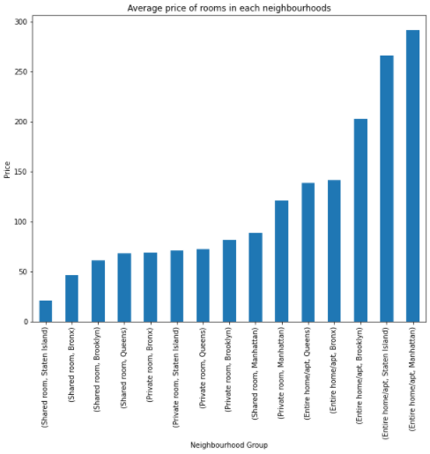
Visualizations
In this bar plot, we have visually shown the average price of the different rooms for different Neighborhood Groups.
We found an Entire apt in
Manhattan has the highest
The average price of $291 and
shared room in Staten Island
has the less average price of
$21.

Slide 14
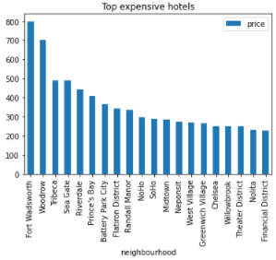
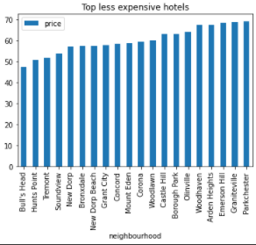
In the above bar plots, we found the top expensive hotels and less expensive hotels.
The top expensive hotel in Fort Wadsworth at $800 and the less expensive hotel is Bull’s Head at $47.

Slide 15
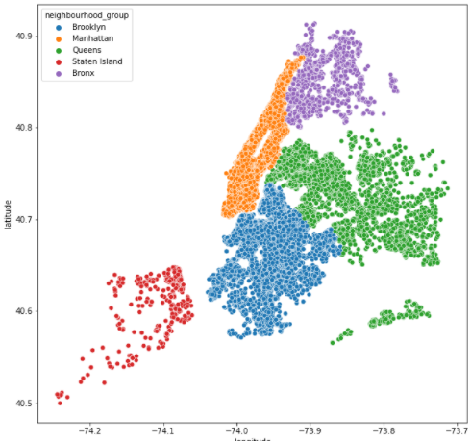
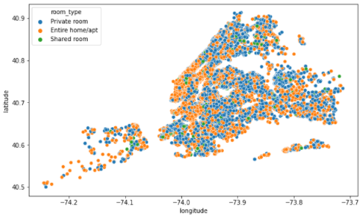
In the above two scatter plots we have used latitude and longitude data to visually see the neighborhood groups and the types of rooms shared across the New York City map.

Slide 16
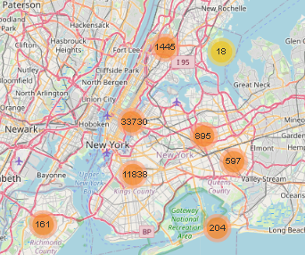
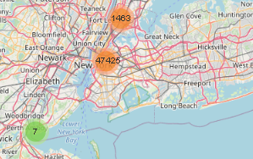
In the above two plots, we are showing the total hotels in clusters we can see the two images one is zoomed out and the other is zoomed in to see the hotels spread across the map.

Slide 17
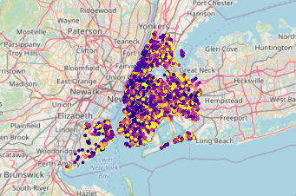
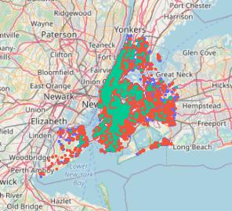
In the above two plots, we can see the hotels available for availability for 365 days and in the second plot, we can see types of rooms spread across the NYC map.

Slide 18
Conclusion
The data of AIRBNB since 2008 has been provided this dataset. This dataset has around 49000 observations with 16 columns and it is a mix of numerical and categorical values.
The detailed Insights from the analysis:
The Neighbourhood of New York City has 5 groups:
Brooklyn
Manhattan
Queens
Staten Island
Bronx

Slide 19
Properties from Manhattan are a bit pricey followed by Brooklyn and Staten Island
Top 3 Hosts from the dataset are:
Sonder(NYC)
Blueground
Kazuya
Since Reviews are important here are the top 3 Hosts who hold the most reviews:
Dona
Asa
Dennis & Nauko

Slide 20
There are 3 room types Entire home/apt. (~25000), Private room(~23000), Shared room(>500)
The visualization that is plotted on maps also shows where all the properties are located along with their price, availability, and the type of room.

Slide 21
Thank You

